Slide 1

Department of CE/IT
EXAMINATION SYSTEM
Mini Project
OODP (01CE1303)
Name:Engidawork
RollNo:91900103183
Class: CE TC3
Batch: C

Slide 2
Introduction
Abstract:
Examination System is targeted for the high schools,colleges,universities and for any other educational institutes.To facilitate the examination process and grading system .For teachers and students it provide a fast and reliable access, like for teachers add (question,answer,mark), display all questions,modify (question,answer,mark),search question,delete the question also. For student Take exam and View Grade to see there result.
The goal of this project is to develop a system for computerization of examination system to increase the quality of education system.

Slide 3
Functionality
List of functionalities
For Teacher
Add
Search
Display
Modify
Delete
Trash
For Student
Take Exam
Display Grade

Slide 4
Strength of Project
Reason for selecting Examination System is, in most of the educational institutes they are facing a lot of problem like lack of paper, cheating on exam and grading is very slow. that is why I selected this project to solve this and other problems.
Advantage: It take minimum resources ,instant grading ,flexible the teacher can change anything any time,safe and secure test
my application can solve all the above problems and in a butter and ease way.

Slide 5
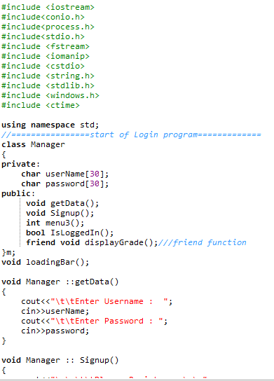
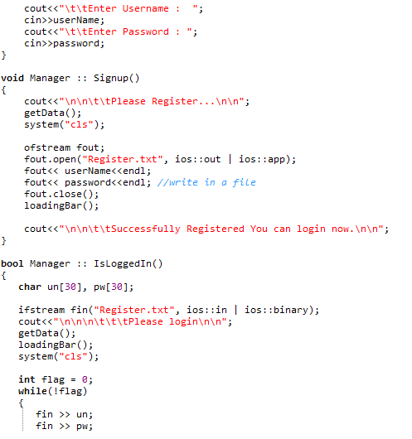
Sample Coding screen shots

Slide 6
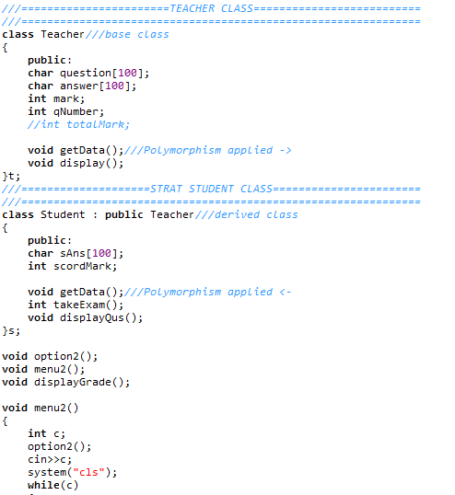
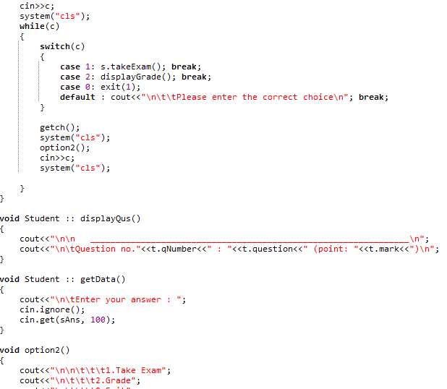
Sample Coding screen shots

Slide 7
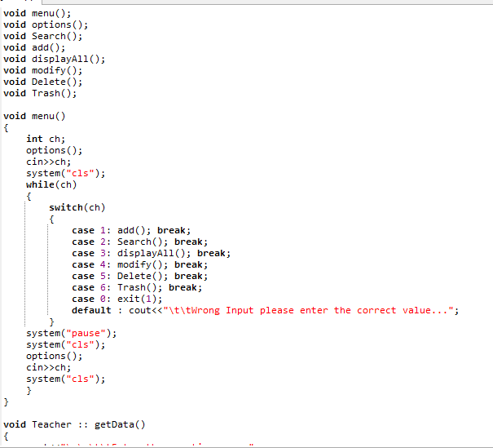
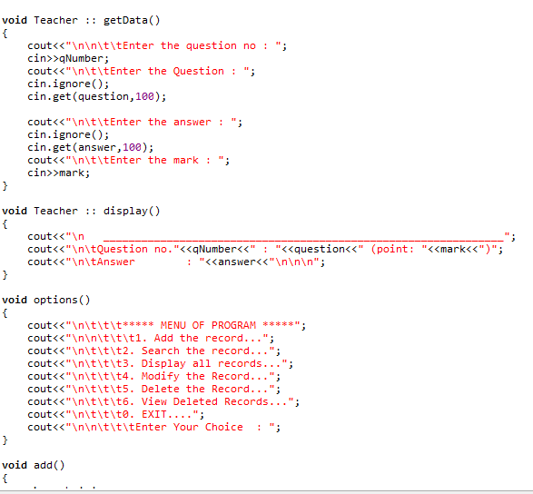
Sample Coding screen shots

Slide 8
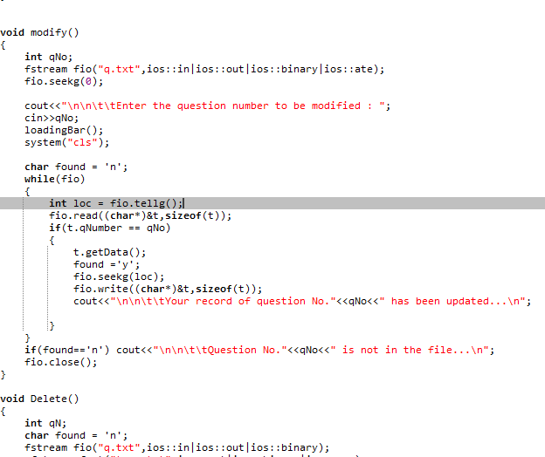
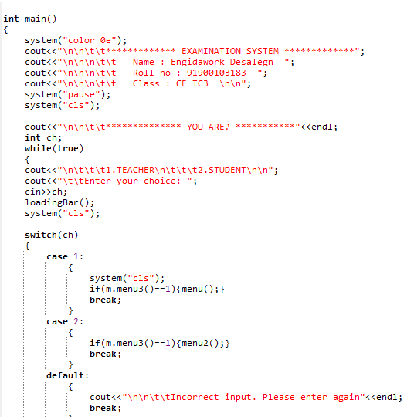
Sample Coding screen shots

Slide 9
Sample Output Screenshots
Login us a Teacher

Slide 10
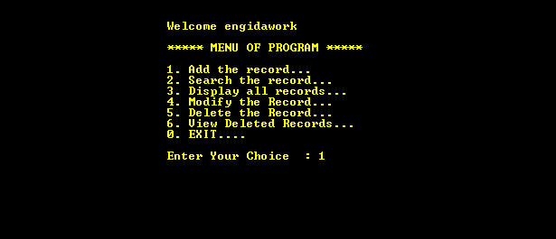
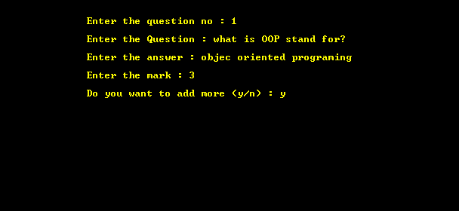
Sample Output Screenshots
ADD Function

Slide 11
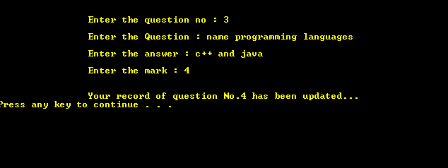
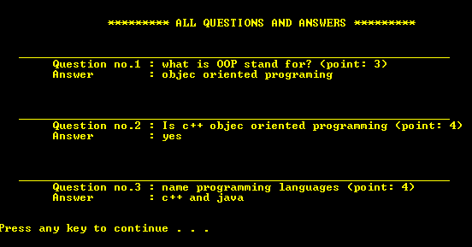
Sample Output Screenshots
Before Update:

Slide 12
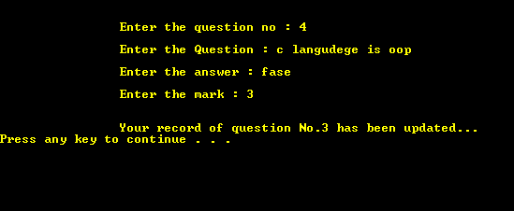
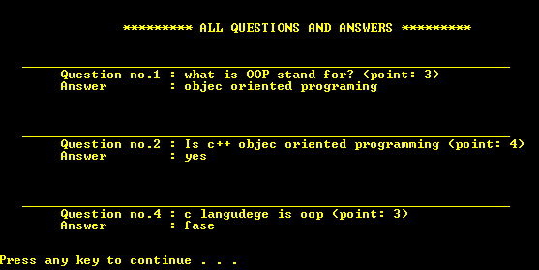
Sample Output Screenshots
After Update:

Slide 13
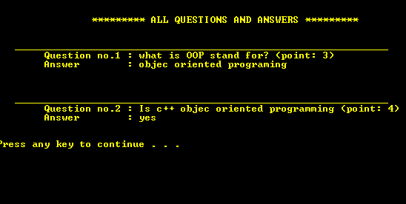
Sample Output Screenshots

Slide 14
Sample Output Screenshots
Login as a Student

Slide 15

Sample Output Screenshots
Student welcome page

Slide 16
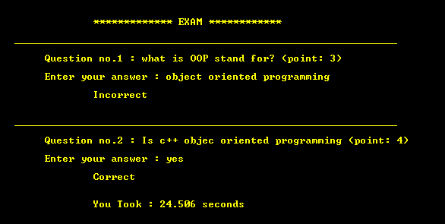
Sample Output Screenshots
Student Taking exam:

Slide 17
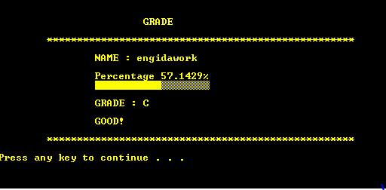
Sample Output Screenshots
Grade output:

Slide 18
Limitations / Extension
Limitation:
I tried my best to make this project complete but there will be some limitation due to limitation of time and knowledge. like comment section and login system is only for one person.
Extension:
Despite the previous limitations this application can be enhanced to an upgraded level by the addition of certain feature.
I can add the comment feacher.

Slide 19
Thank you

